Slide 1

CLICK TO CHART
CLICK TO CART
Naushin Azi- 16WH1A1249 Internal Guide
Shaik Sumera Sultana-16WH1A1255 Ms. P. Sree Lakshmi
Asst.Professor

Slide 2
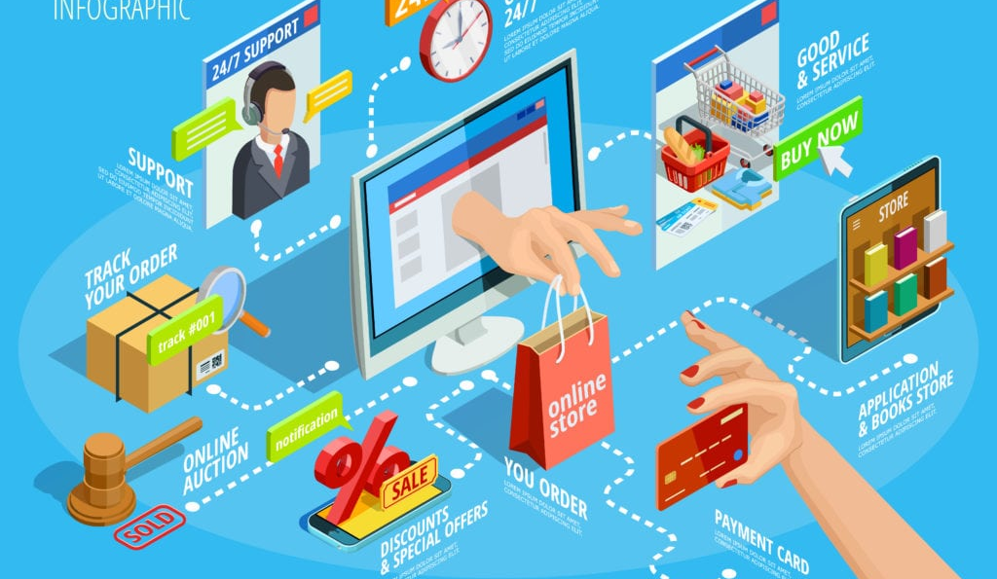
WHAT IS E-COMMERCE :
It is commonly known as electronic marketing.
It consist of buying and selling goods and services over an electronic system such as the internet.
E-commerce is the purchasing , selling & exchanging goods and services over computer network or internet through which transactions or terms of sale are performed electronically.

Slide 3
WORKING PRINCIPLE….
A consumer uses Web browser to connect to the home page of a merchant's Web site on the Internet.
The consumer browses the catalogue of products featured on the site and selects items to purchase. The selected items are placed in the electronic equivalent of a shopping cart.
When the consumer is ready to complete the purchase of selected items, they provides a bill-to and ship-to address for purchase and delivery.

Slide 4
WORKING PRINCIPLE….
When the merchants Web server receives this information, it computes the total cost of the order-- including tax, shipping, and handling charges--and then displays the total to the customer.
The customer can now provide payment information, such as a credit card number, and then submit the order.

Slide 5
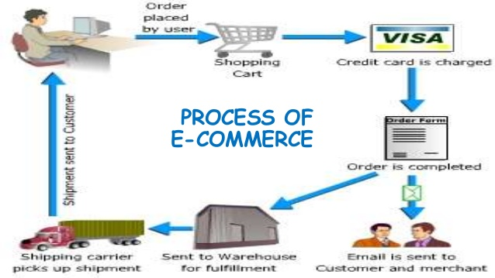

Slide 6
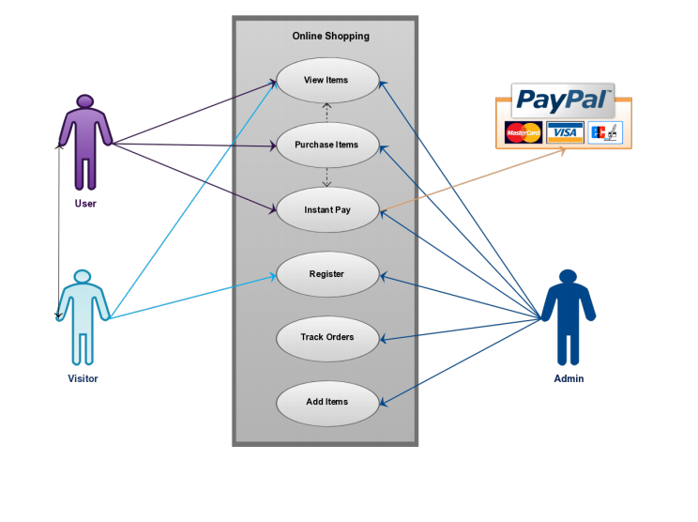
USE CASE DIAGRAM

Slide 7
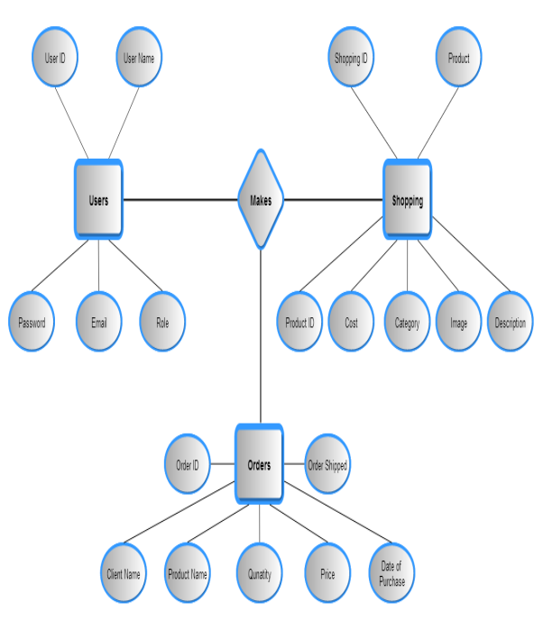
RELATIONSHIP DIAGRAM

Slide 8

FEATURES…..
Any member can register and view available products.
Only registered member can purchase multiple products regardless of quantity.
There are three roles available:
Visitor
User
Admin.

Slide 9
ADMIN MODULE
Administrators are the ones who add or administer the categories for the products, and administers the Vendor.
Administrator can add product to database.
Administrator can edit or delete the products from the database

Slide 10
USER MODULE
The customers register with their details.
Customers are provided with information on the products available by categories.
Using Shopping Cart, see the item selected appears in the shopping.

Slide 11

DATA MANAGEMENT
This database consists of
Users: User and Admin information is added to database with Unique ID based on their roles.
Shopping: Complete products information is stored in this table.
Orders: Customer ordered products, status and delivery information is stored in this table.

Slide 12
TOOLS AND LANGUAGES USED…..
XAMPP Server
CSS
PHP
HTML
Bootstrap
MySQL
Sublime Text Editor

Slide 13
WEB PAGE DETAILS.....
Admin Registration And Login
Customer Registration
Welcome And Login Page
Product Category Display Page
Product Details
Product Selection Screen
View Cart Screen
Order Details Screen

Slide 14
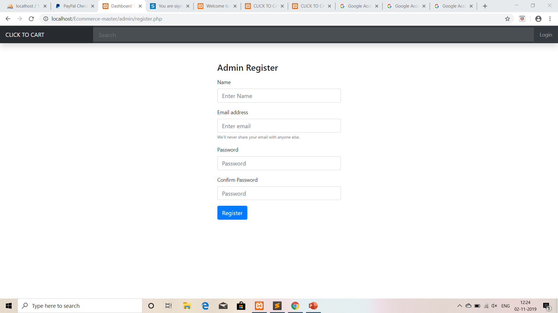
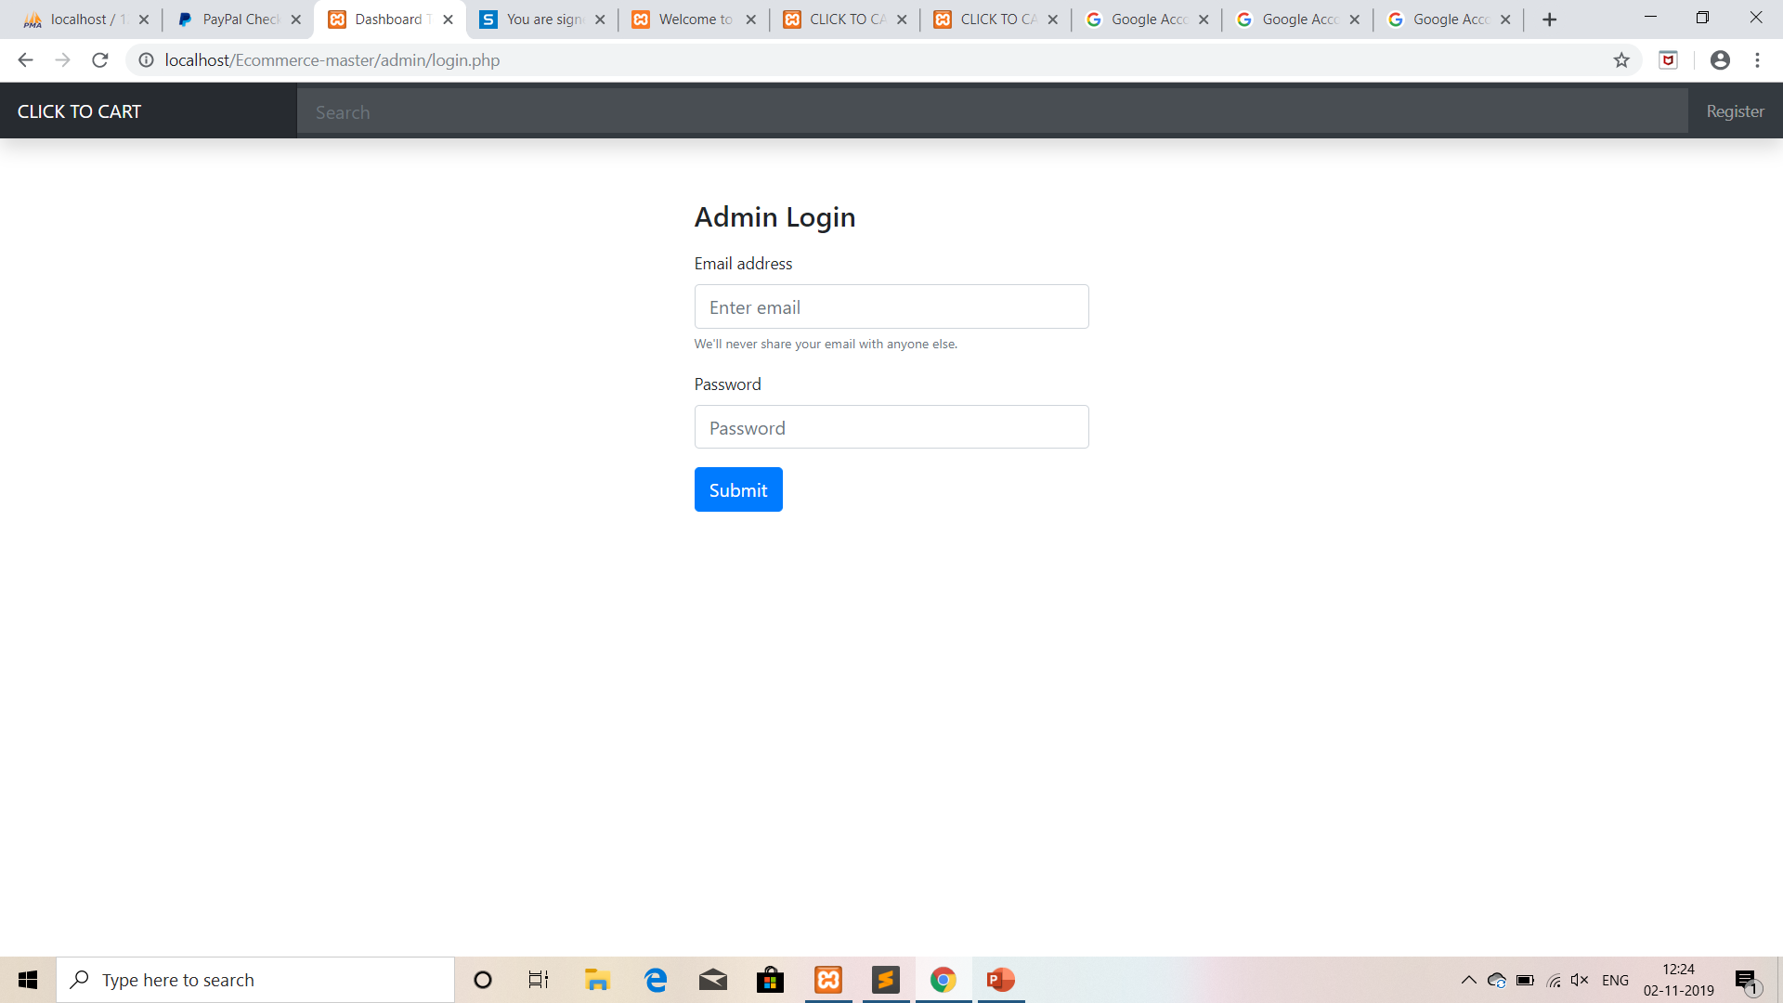
Admin Registration And Login

Slide 15
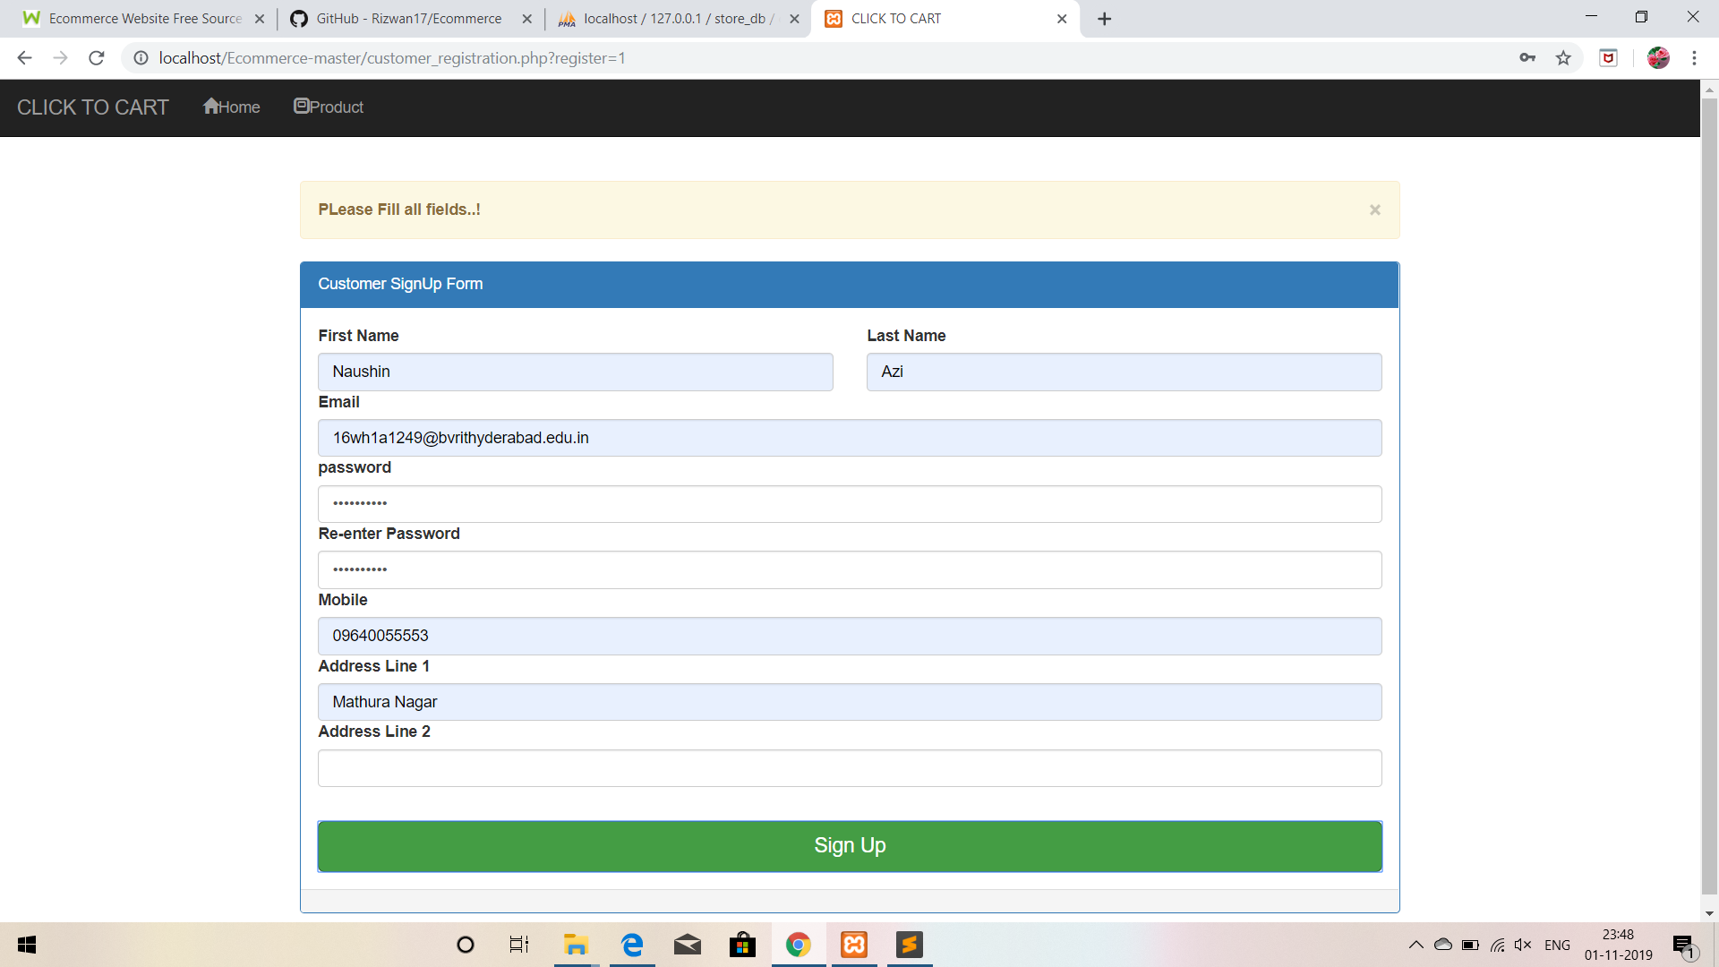
Customer Registration

Slide 16
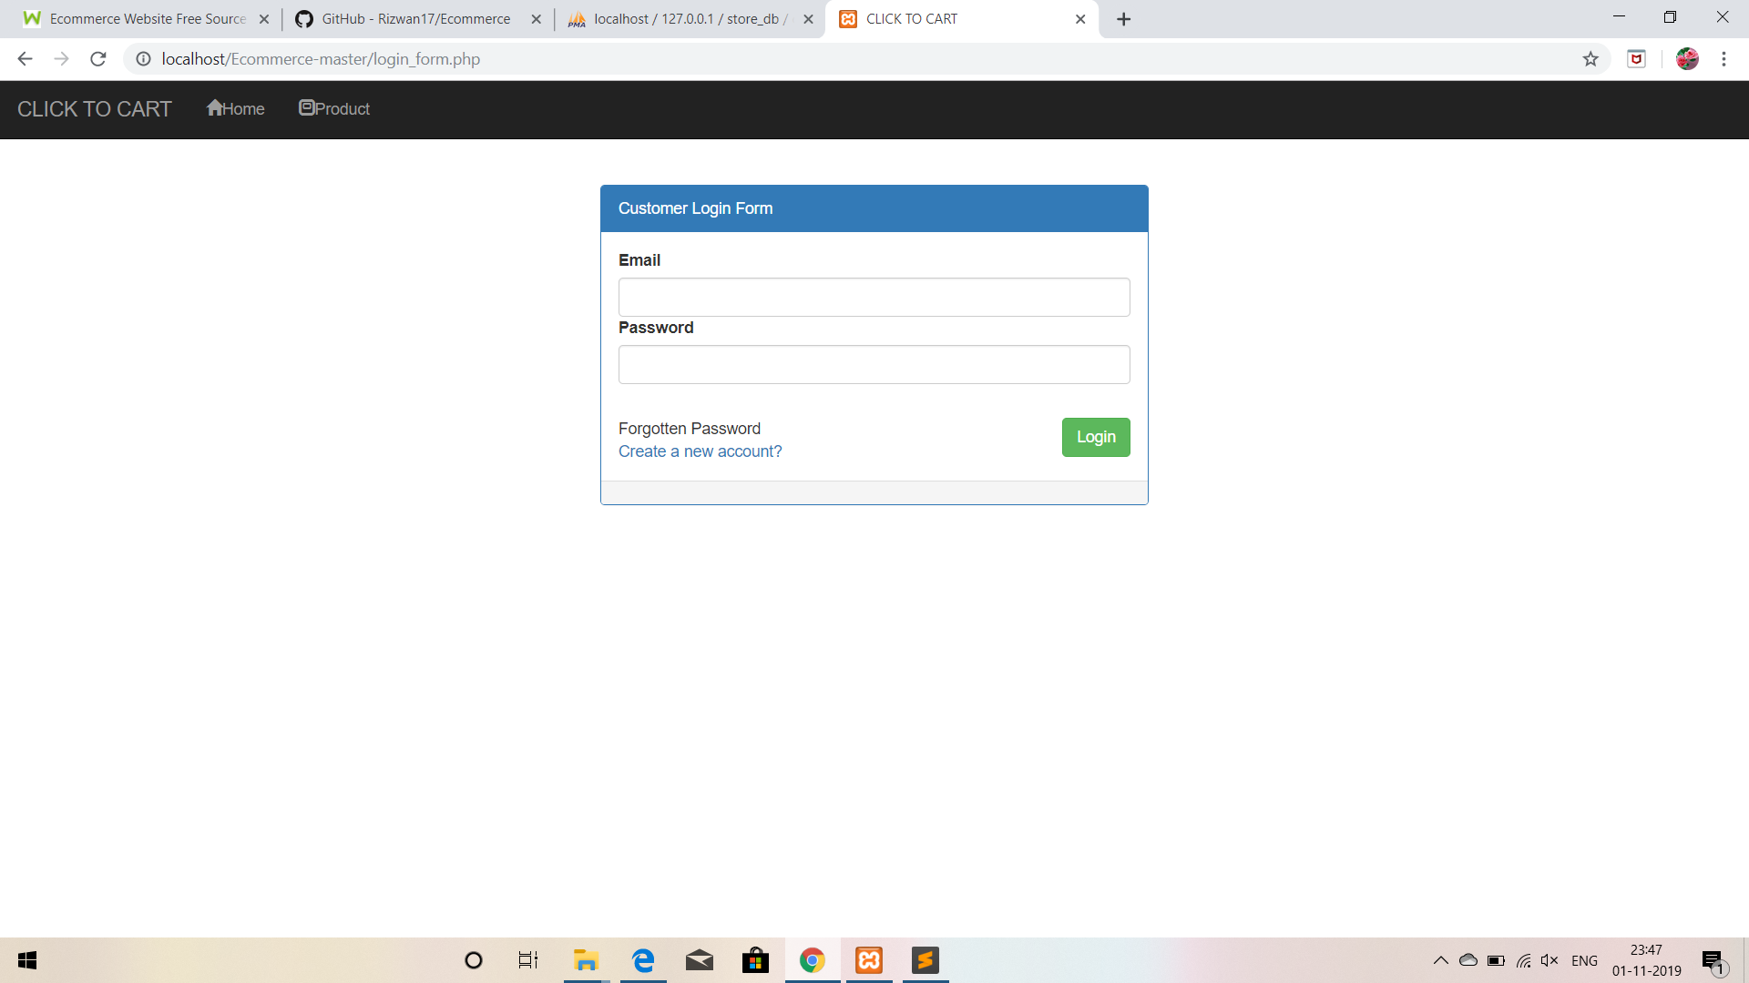
Login Page

Slide 17
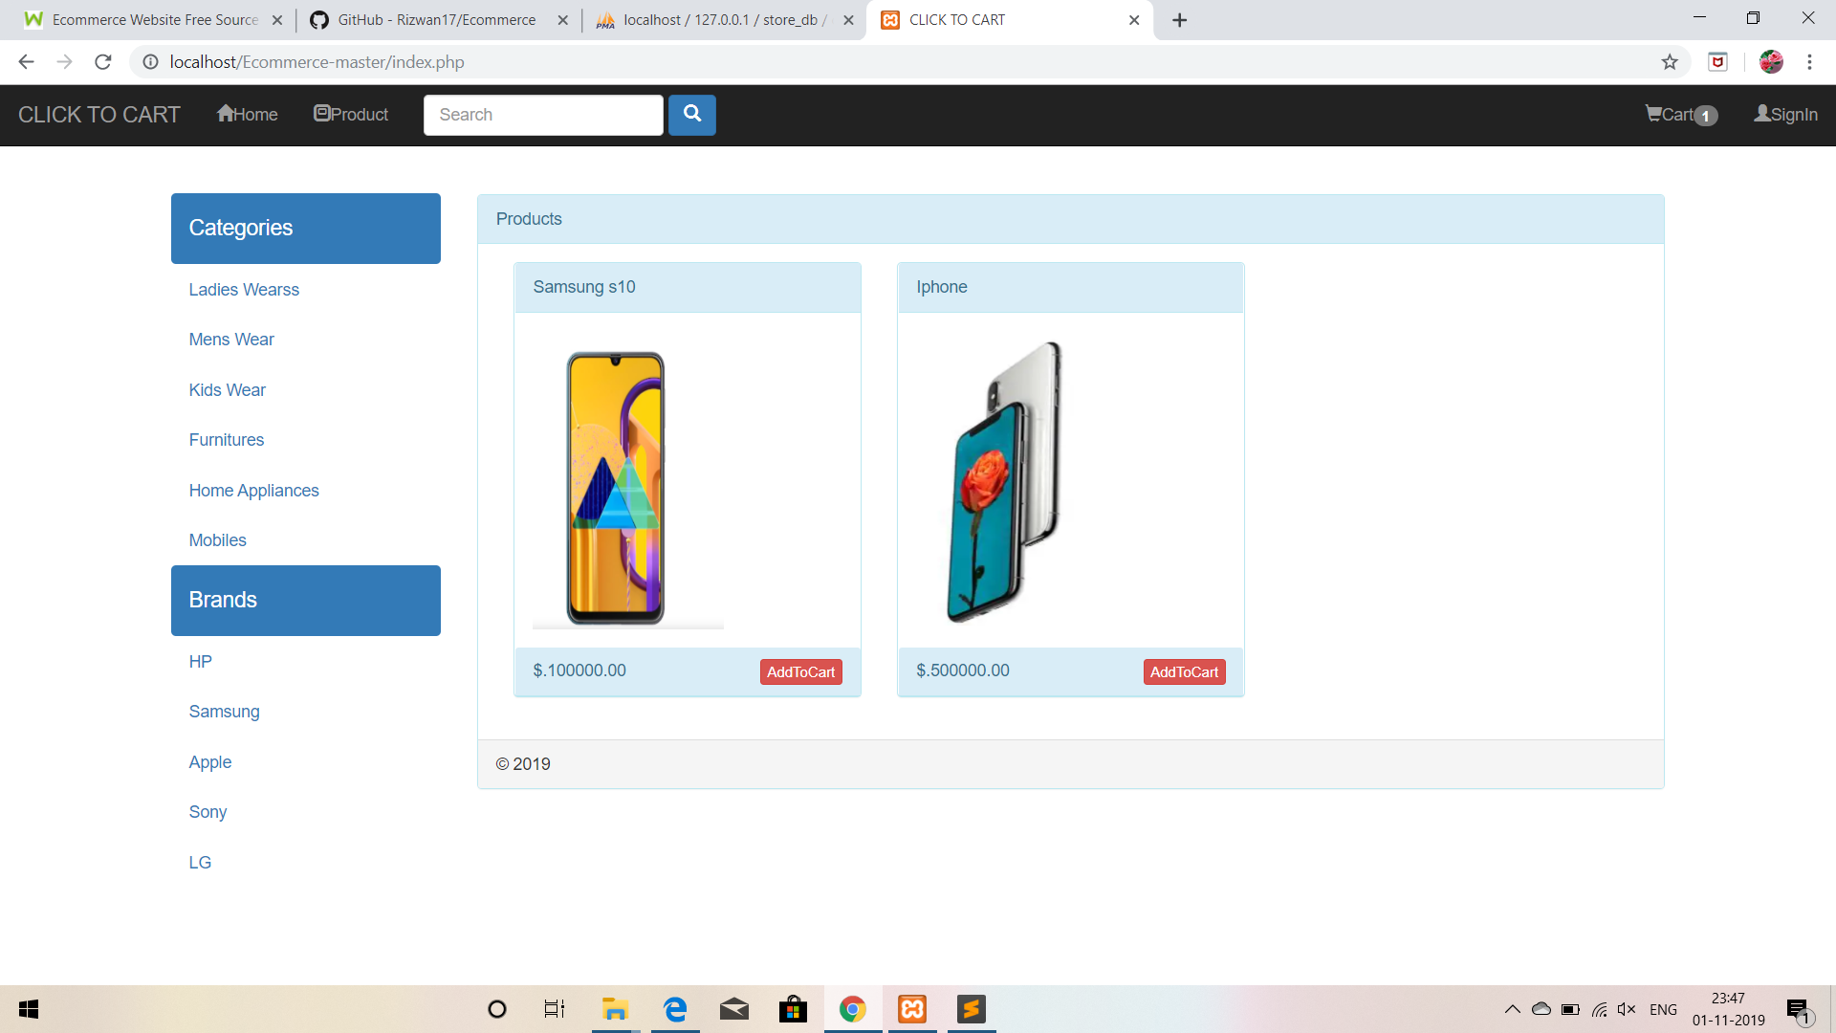
Product Category Display Page

Slide 18
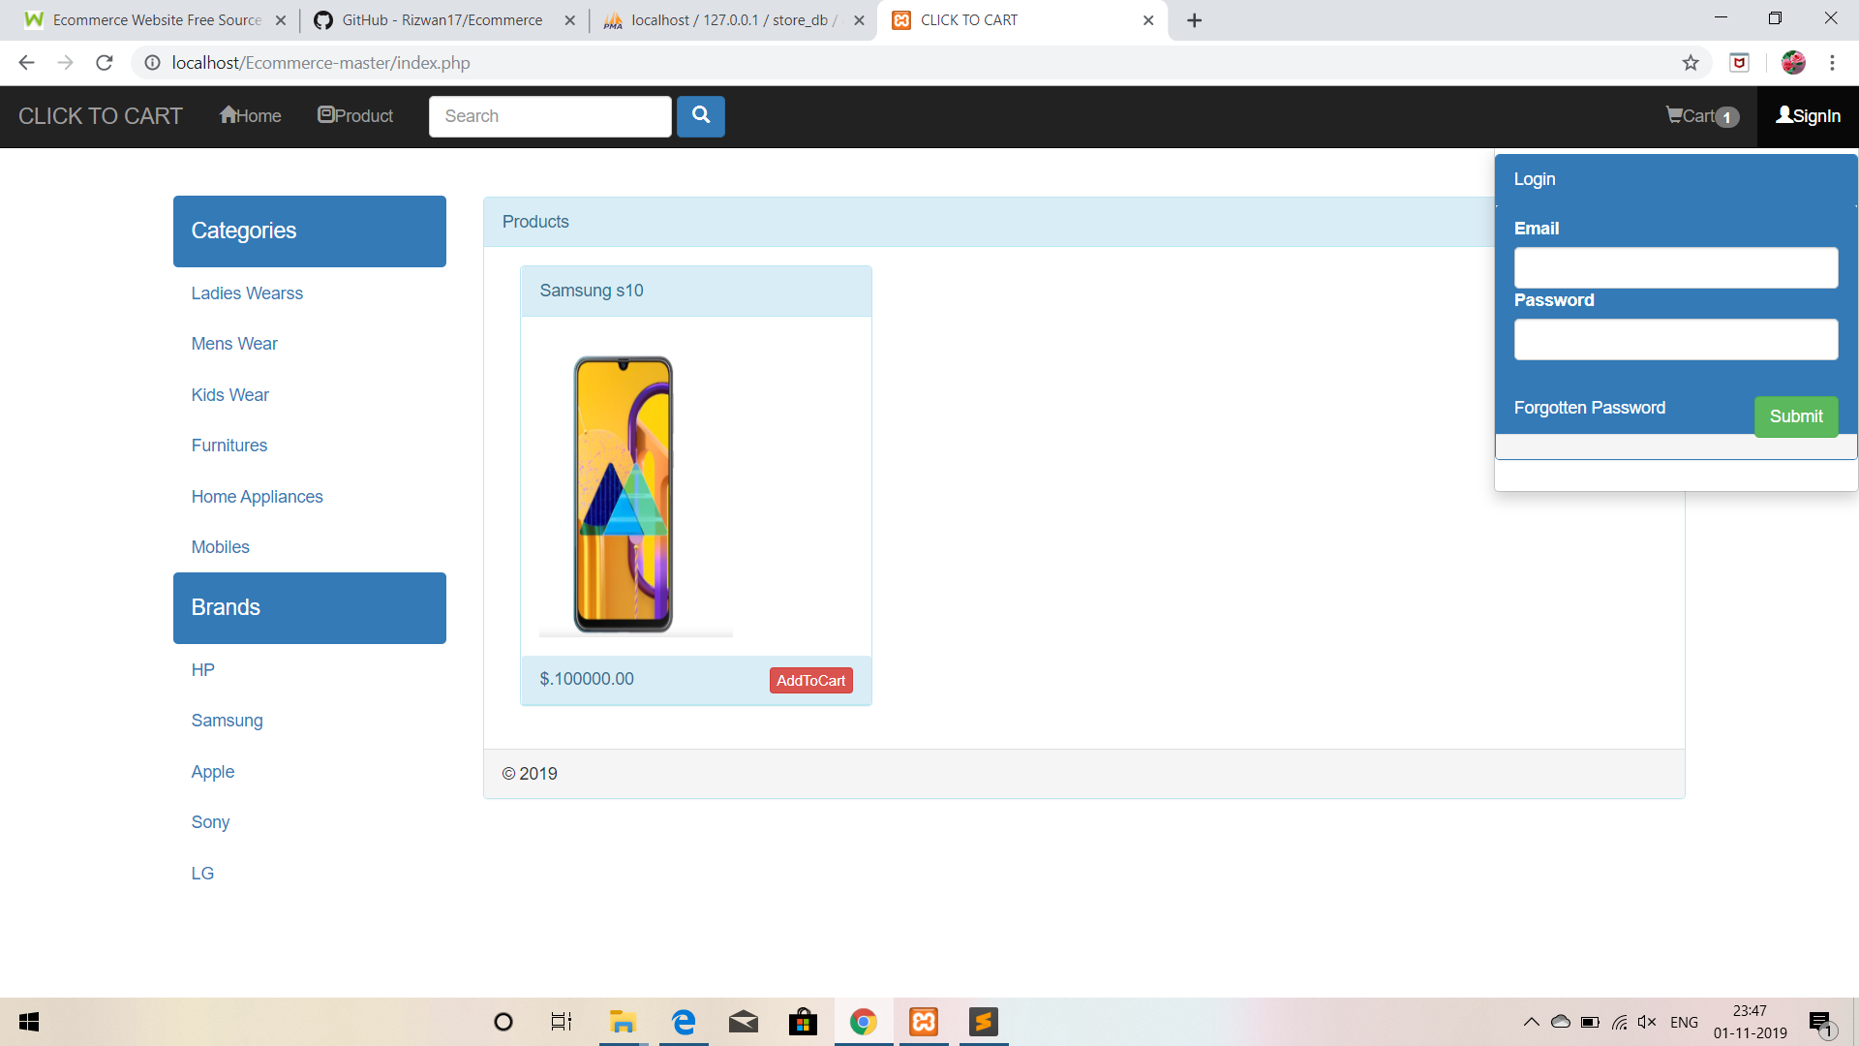
Product Selection Screen

Slide 19
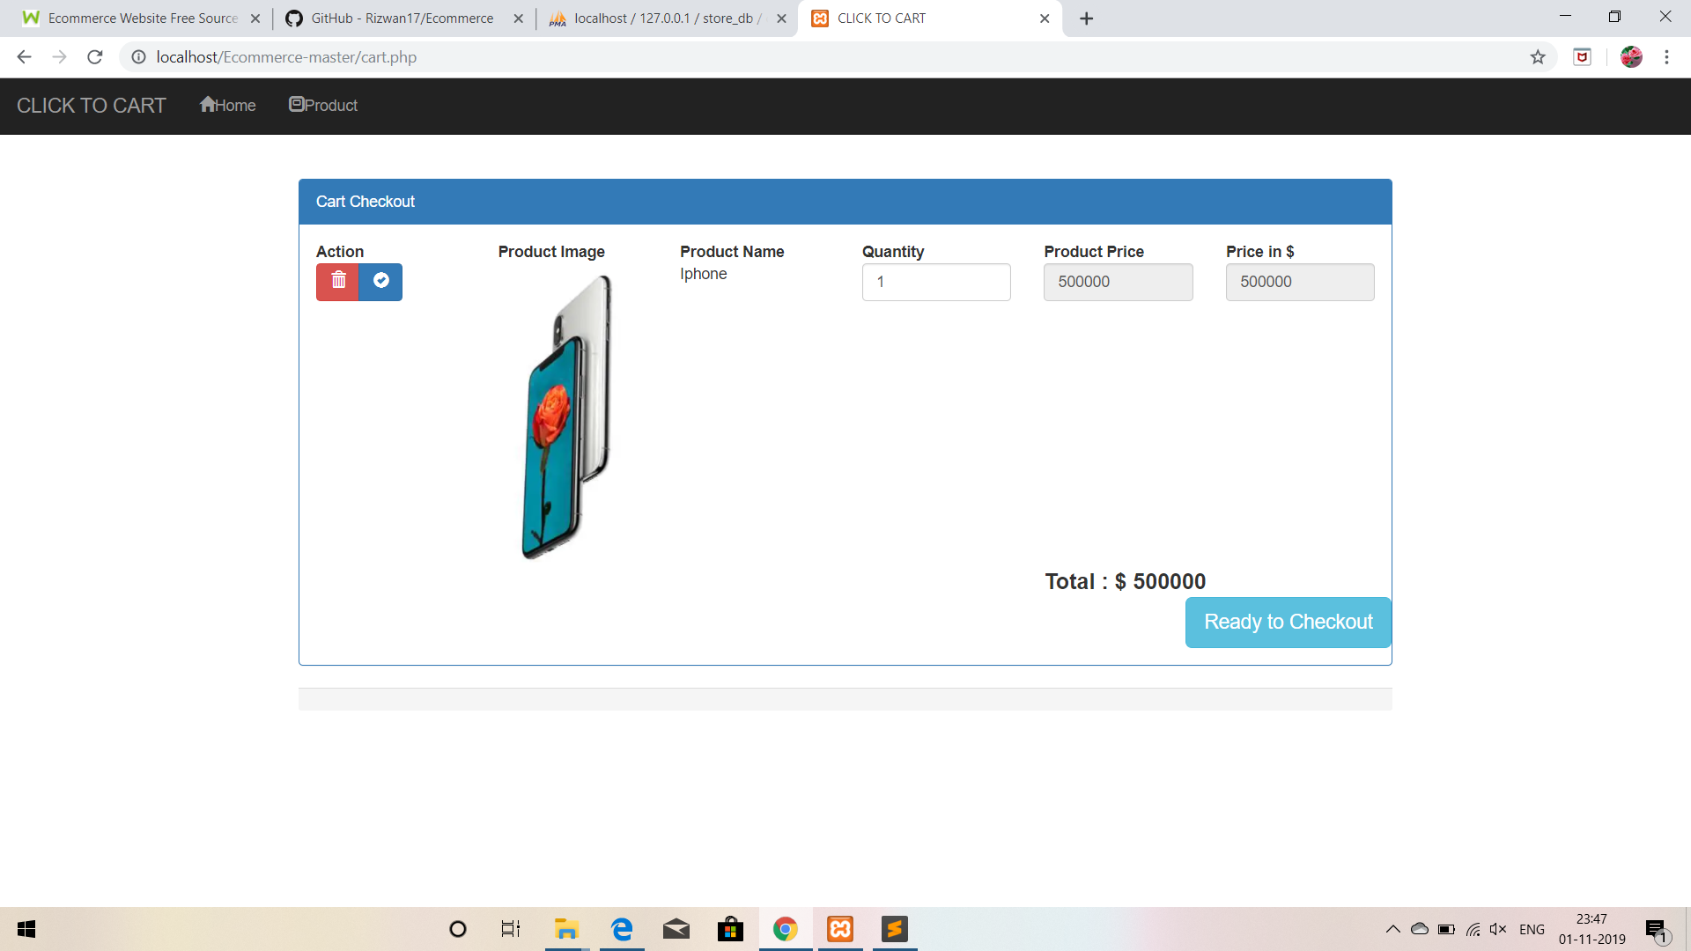
View Cart Screen

Slide 20

ADVANTAGES
Faster buying/selling procedure, as well as easy to find products.
Buying/selling 24/7.
More reach to customers, there is no theoretical geographic limitations.
Low operational costs and better quality of services.
No need of physical company set-ups.
Easy to start and manage a business.
Customers can easily select products from different providers without moving around physically.

Slide 21

CONCLUSION
The Internet has become a major resource in modern business, thus electronic shopping has gained significance not only from the entrepreneur’s but also from the customer’s point of view. For the entrepreneur, electronic shopping generates new business opportunities and for the customer, it makes comparative shopping possible.

Slide 22
REFERENCES
http://www.w3schools.com
http://www.php.net
https://youtu.be/C1phgYAzIfg

Slide 23


